Slide 1
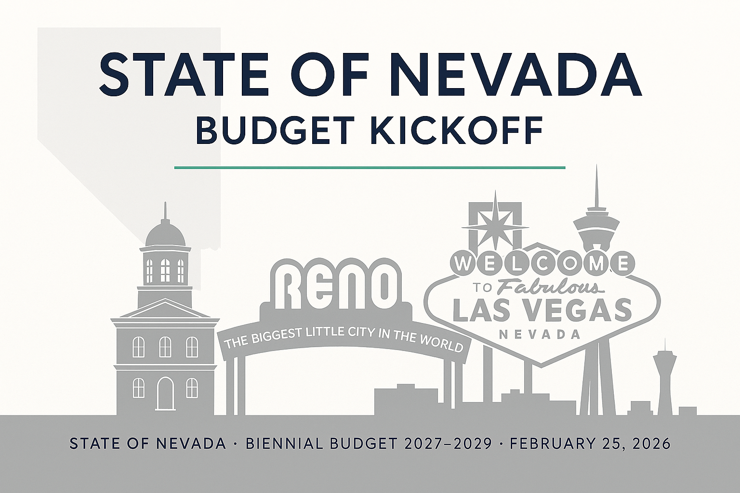
Graphic is a product of Microsoft 365 Copilot

Slide 2
State of Nevada
Executive Budget Kickoff
Good Morning
& Welcome!
Tiffany Greenameyer
Director
Governor’s Finance Office
Governor's Finance Office - February 25, 2026

Slide 3
Agenda
GFO Welcome
Economic Overview
Budget Build Overview
Statewide Agency Updates
Budget Building Manual Overview
NEBS Update and SB462-Adjusted Base
Q & A
Governor's Finance Office - February 25, 2026

Slide 4
Economic Overview
Dr. Mauricio Solorio Arteaga
Chief Economist
Governor’s Finance Office
Governor's Finance Office - February 25, 2026

Slide 5
Agenda
National Economy
Nevada Economy
Short Term Expectations
State Resources
Governor's Finance Office - February 25, 2026

Slide 6
National Economy

Slide 7
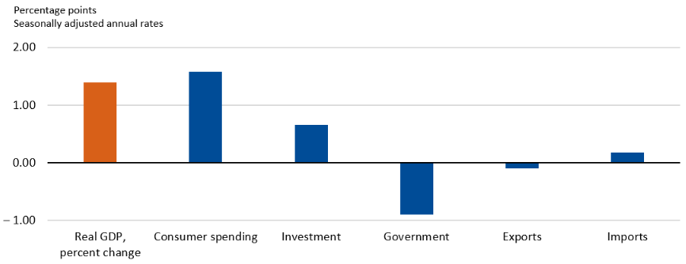
Contribution to % Change in Real GDP, 2025:Q4
Source: Bureau of Economic Analysis
Notes:
Growth in Q3 was bolstered by strong consumer spending and business investment (particularly in AI-related spending)/

Slide 8
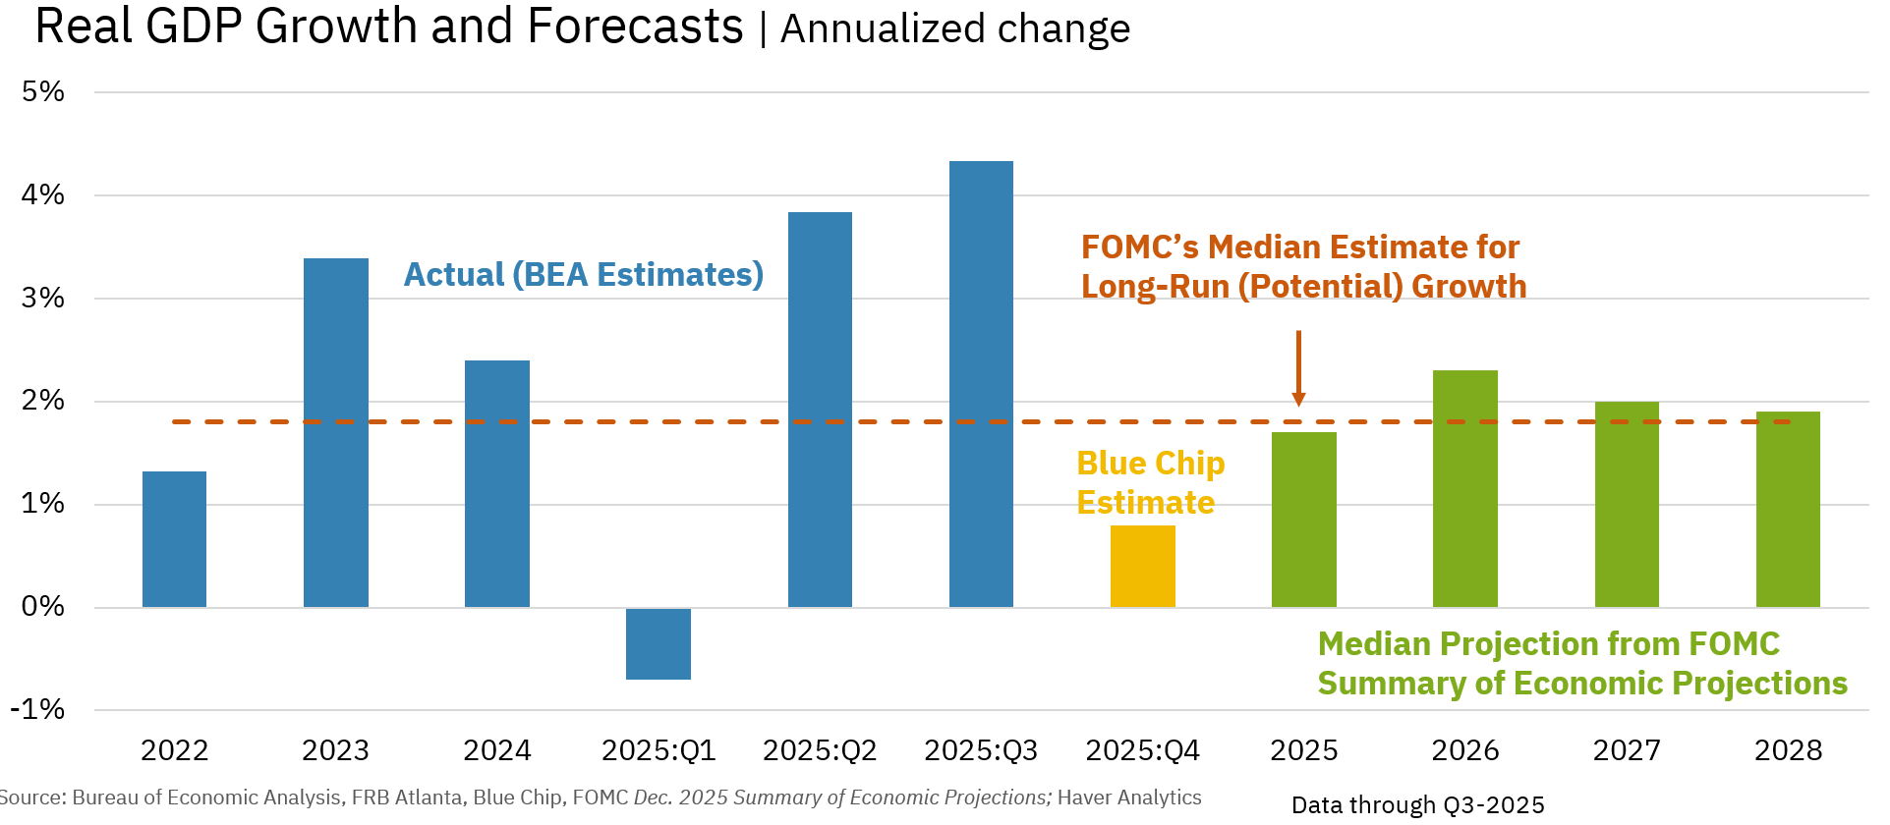
Real GDP Growth & Forecast
Governor's Finance Office - February 25, 2026
Notes:
Federal Open Market Committee – Increase of 4.3% Q3

Slide 9
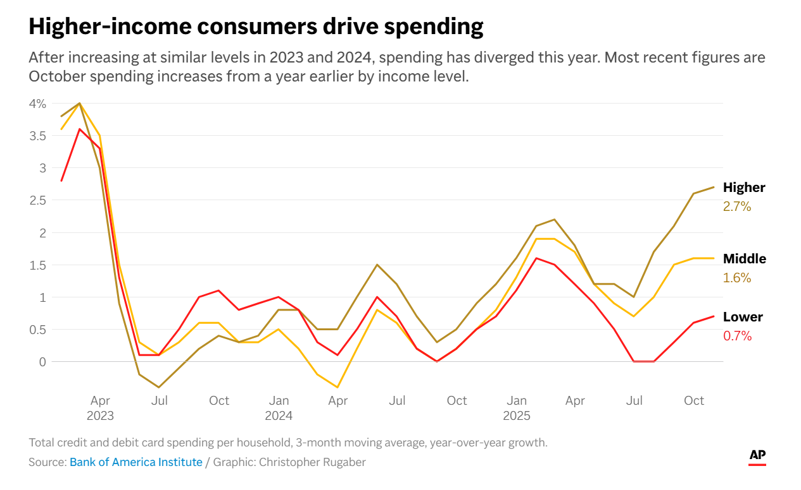
Consumer Driven Spending

Slide 10
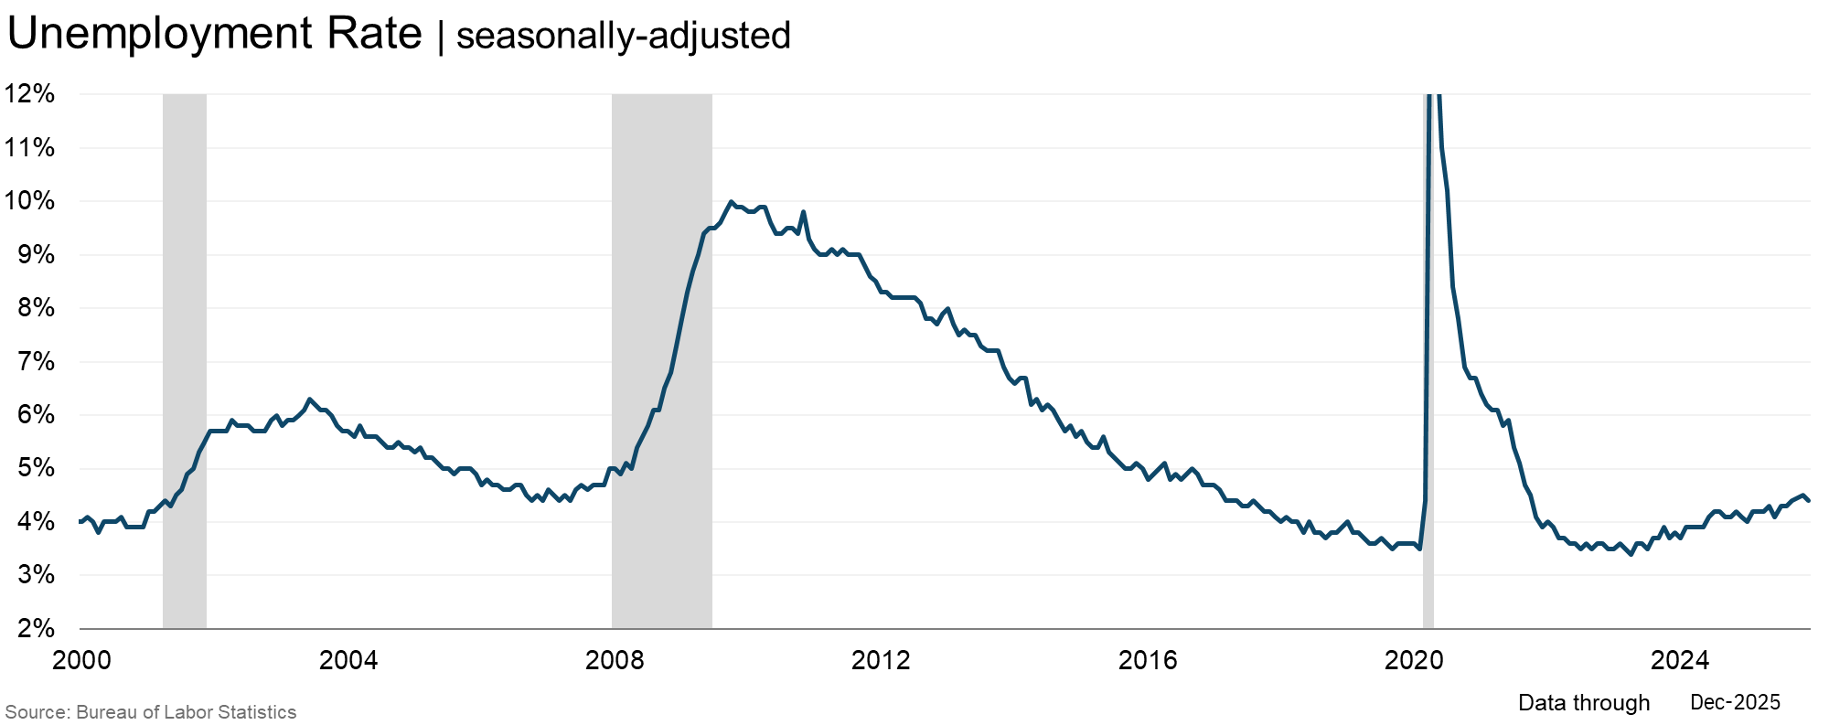
U.S. Unemployment Rate
4.4%
Notes:
The unemployment rate remains at a level that is consistent with a balanced labor market around 4.4

Slide 11
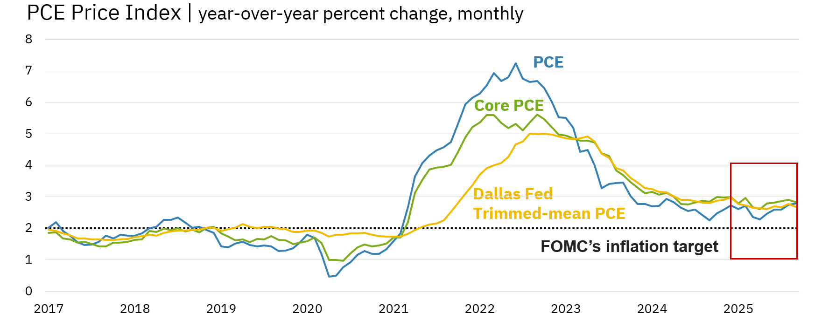
Personal Consumption Expenditures (PCE) Price Index
YoY % Change
2.8%
Sources: Bureau of Economic Analysis; Federal Reserve Bank of Dallas; Haver Analytics. Data through Sept-2025.
Notes:
On a year-over-year basis, progress on moving inflation toward the FOMC’S 2-percent objective has been elusive – 2.8 Nove (as of Feb 10) – New release Feb20

Slide 12
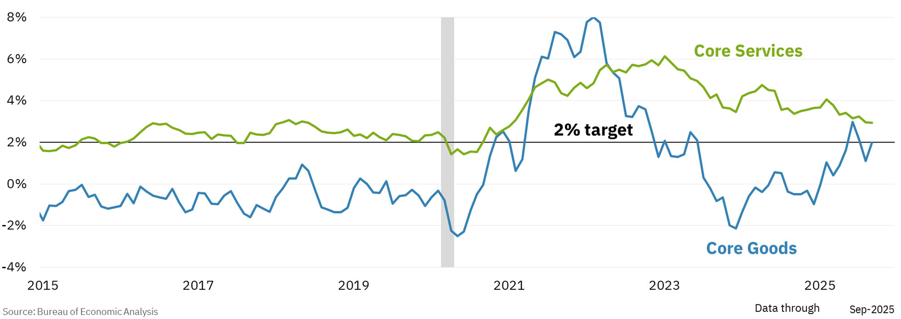
Core Services vs Core Goods
Notes:
The tariff effect looks clear in goods prices, but services price growth remains elevated above pre-pandemic levels as well

Slide 13
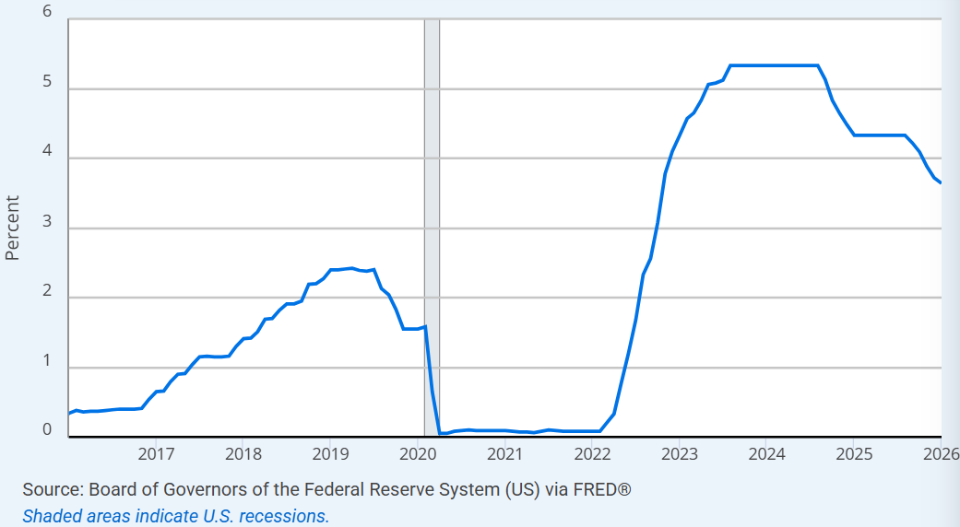
Federal Funds Effective Rate
3.64%

Slide 14
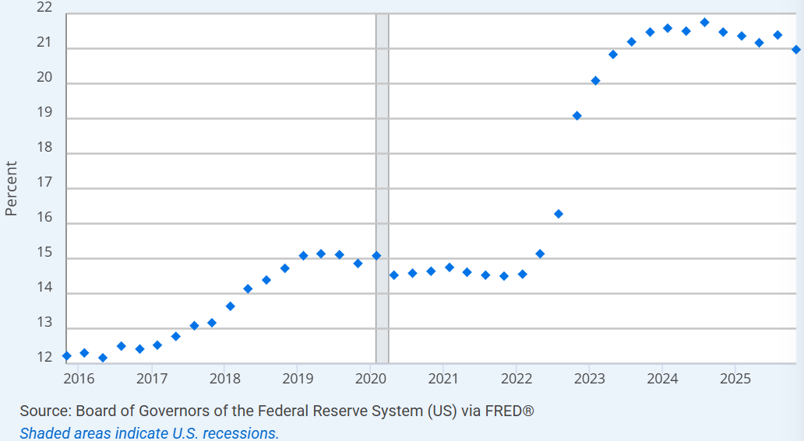
Commercial Bank Interest Rate on Credit Card Plans
20.97%

Slide 15
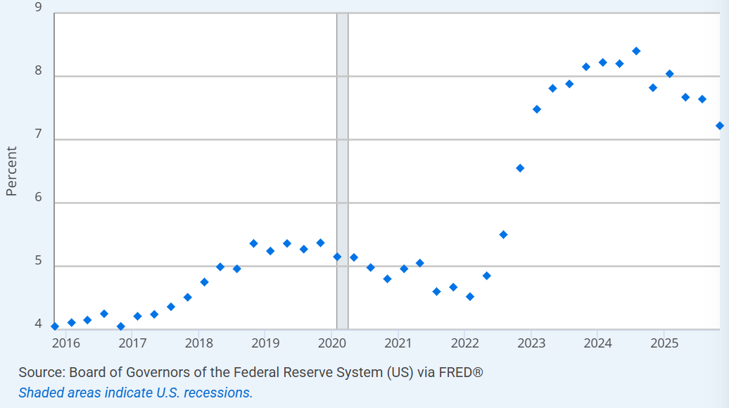
New Autos 60 Month Loan
7.22%

Slide 16
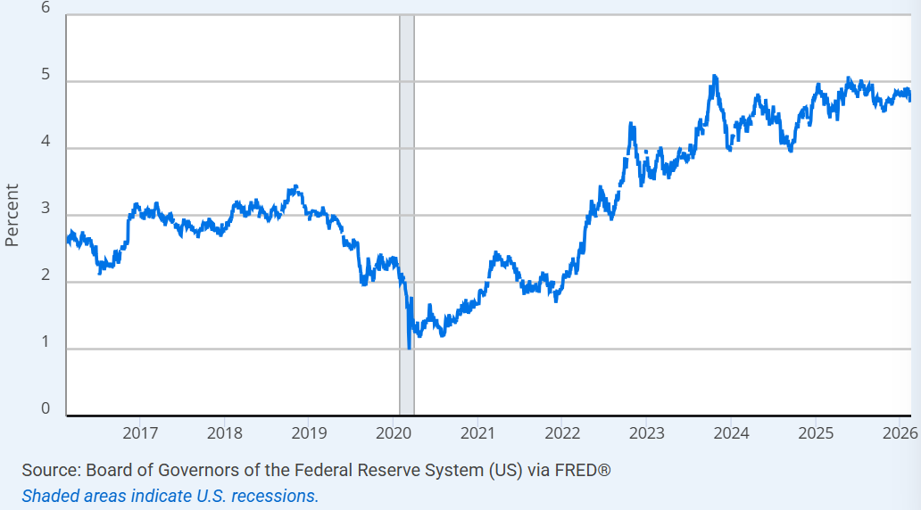
Market Yield on U.S. Treasury Securities at 30-Year Constant Maturity
4.7%

Slide 17
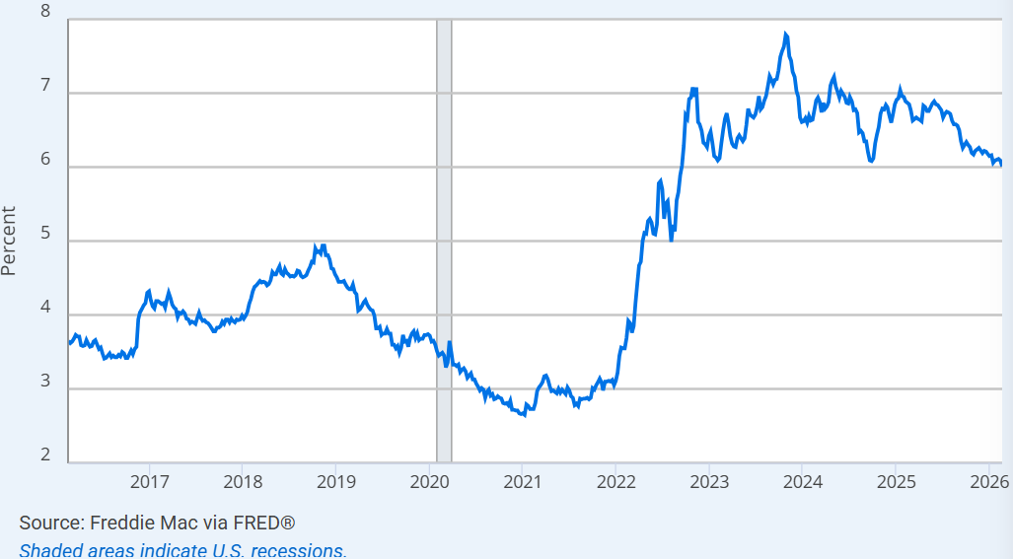
30-Year Fixed Rate Mortgage Average in the United States
6.0%

Slide 18
Nevada Economy

Slide 19
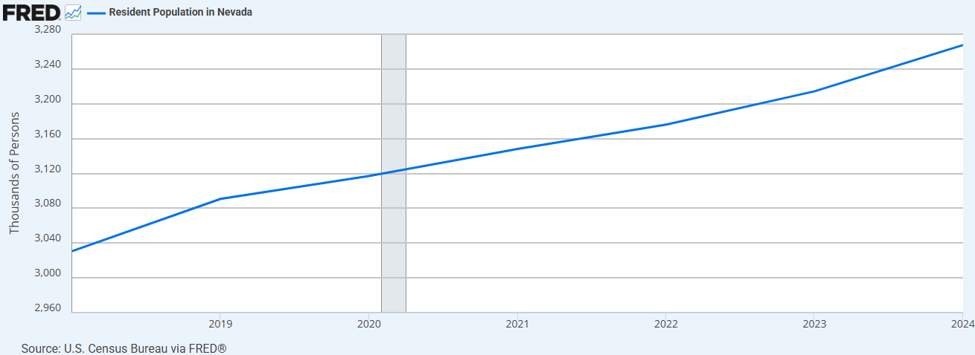
Population
3.26M

Slide 20
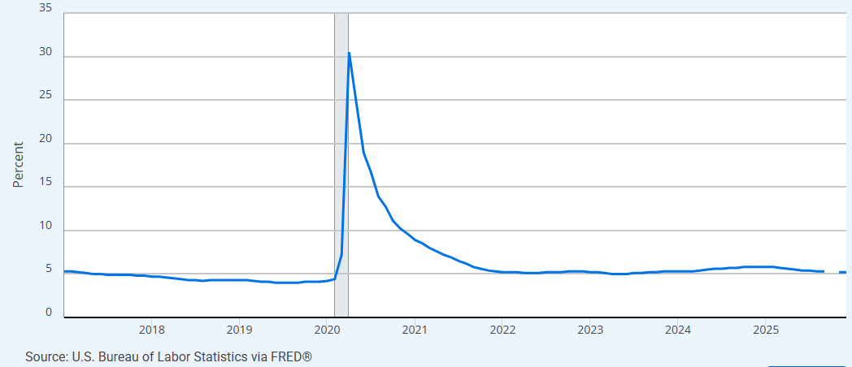
Unemployment Rate
5.2%

Slide 21
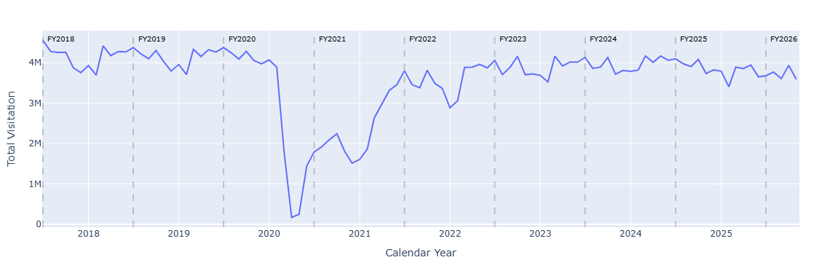
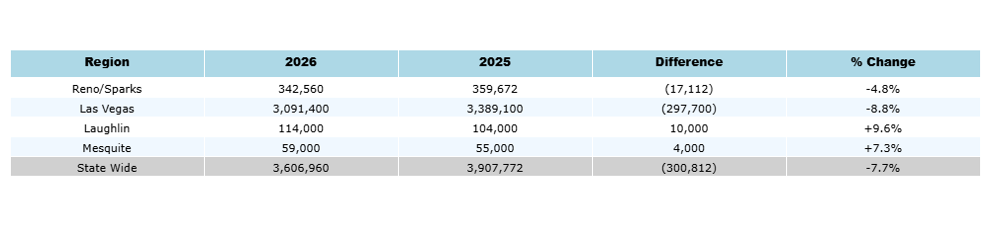
Visitation Numbers
3.6M

Slide 22
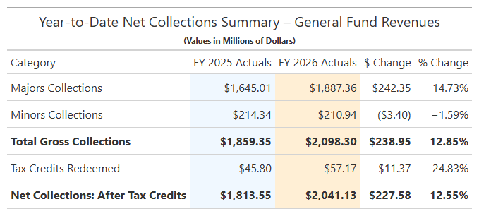
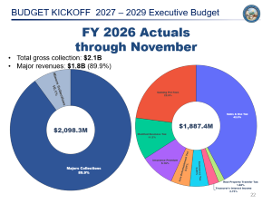

FY26 Actuals vs. FY25 Actuals through November
Major revenues: 14.7% (↑ $242.4M).
Minor revenues: -1.6% (↓ $3.4M)
Overall Gross Collection: 12.9% (↑ $ 238.95M)
  Tax credits redeemed: 24.8% (↑ 11.4M)
Net Collection: 12.6% (↑ $ 227.6M)
Note: $82.8 million dollars of Commerce Tax from FY25 are being distributed into the FY26.

Slide 23
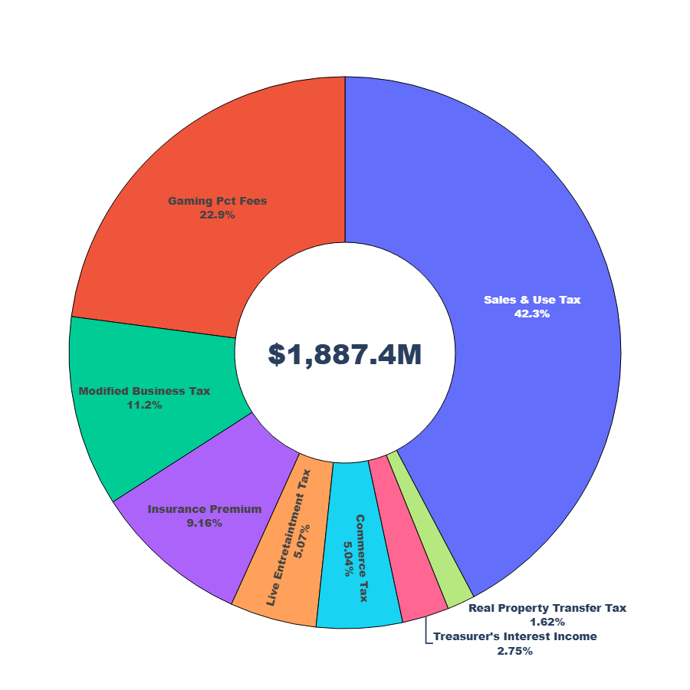
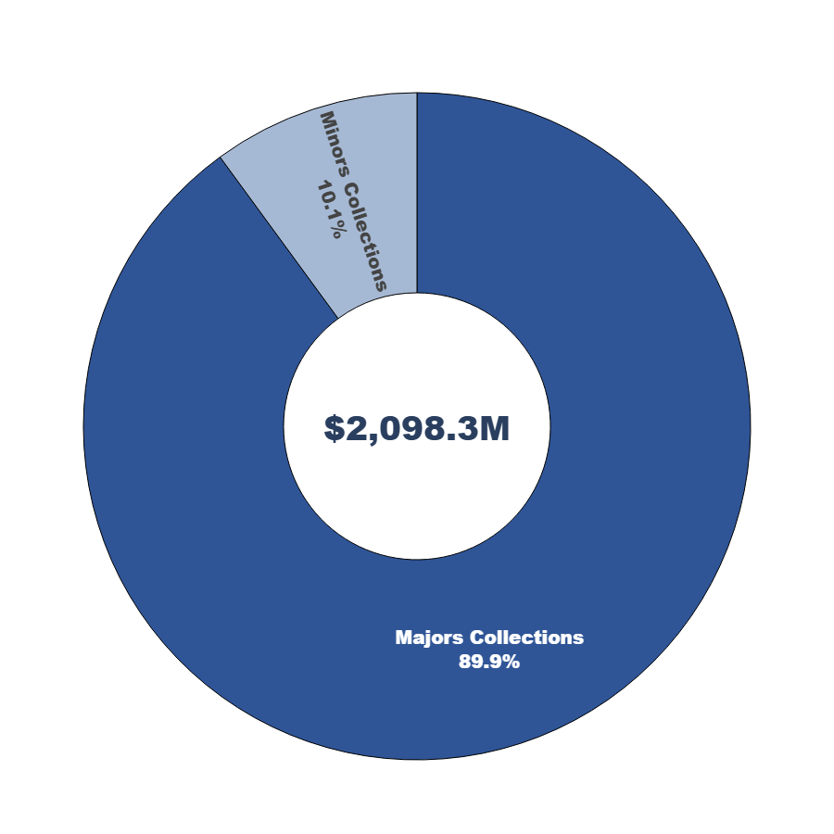
FY 2026 Actuals through November
Total gross collection: $2.1B
Major revenues: $1.8B (89.9%)

Slide 24
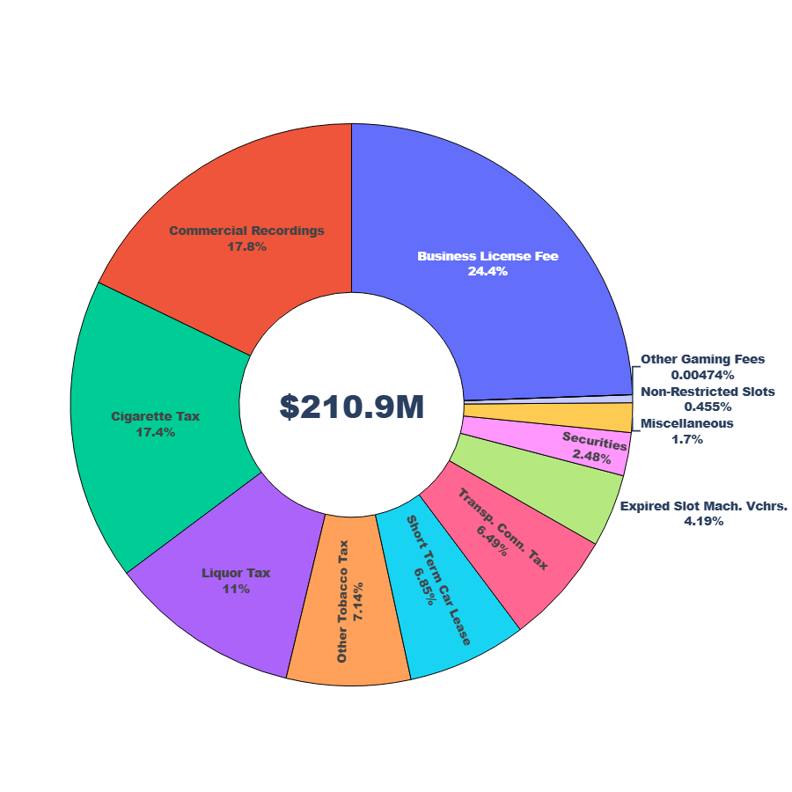
Minor revenues: $210.9M (10.1%)

Slide 25
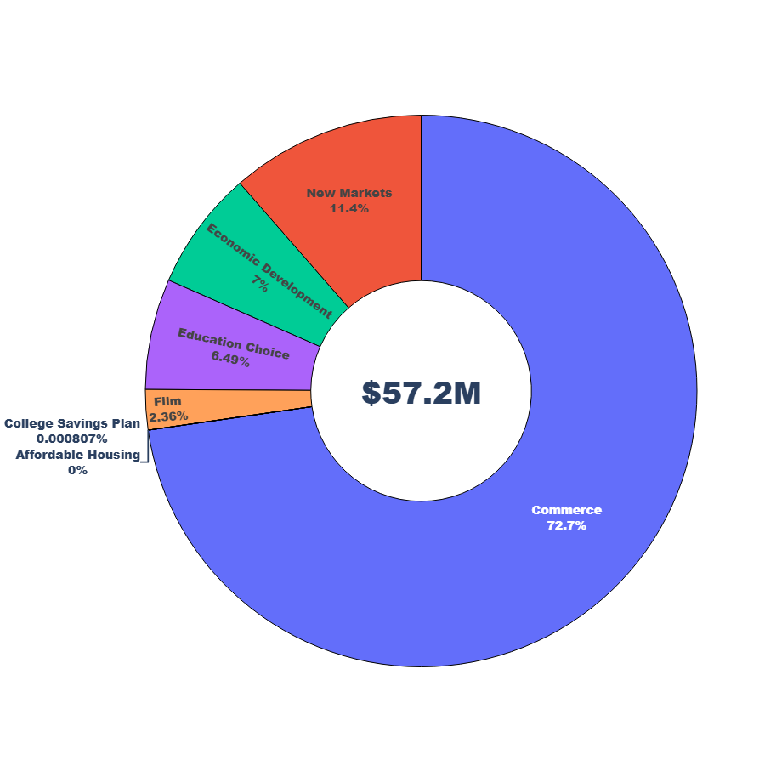
Total Tax Credits Redeemed

Slide 26
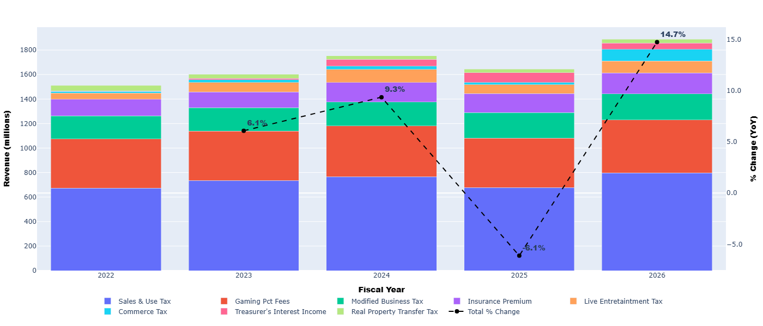
Through Nov. Historical Trend Major Revenue Sources
9.3%
6.1%
6.1%
Note: A significant portion of the percent growth in Sales & Use Tax beginning in November FY26 is attributable to FY25 collection and distribution issues associated with the implementation of a new tax system (MYNT) in November 2025.

Slide 27
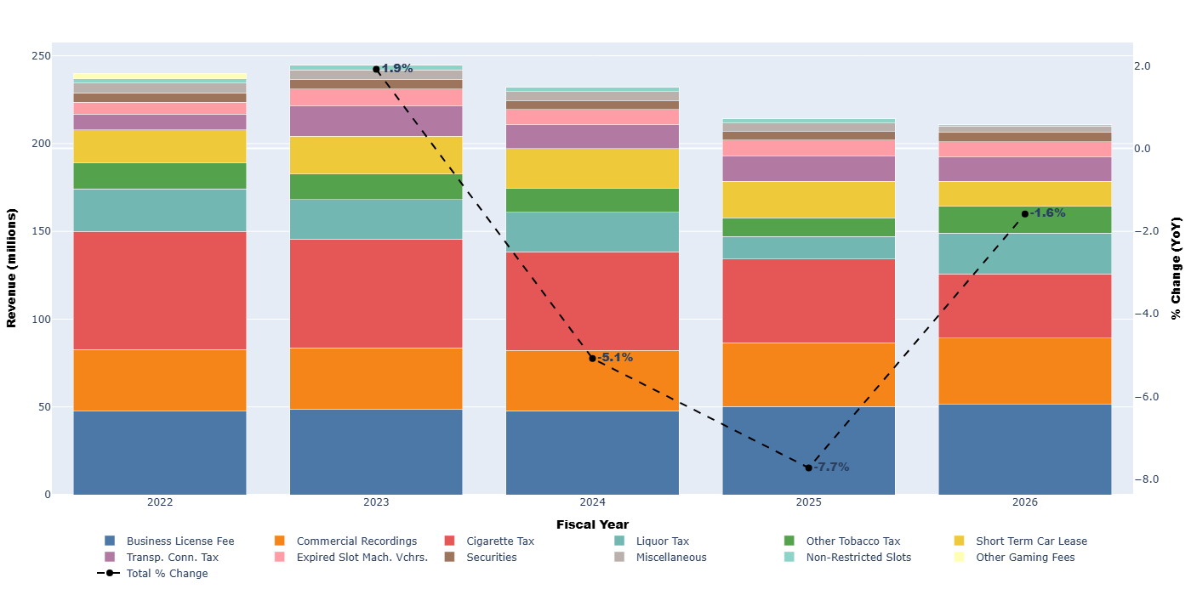
Through Nov. Historical Trend Minor Revenue Sources
1.9%
1.6%
5.1%
7.7%

Slide 28
Short Term Expectations
Sales & Use Tax and Gaming Percent Fees are expected to remain stable as borrowing costs ease with declining interest rates and visitation stabilizes.
Live Entertainment Taxes are expected to continue rising as younger generations prioritize live events and travel experiences rather than big-ticket purchases.
Real Property Tax is expected to increase as the “locked-in” effect dissipates and buyers and sellers adjust mortgage-rate expectations to today’s rates.
Overall, revenues are on track to meet forecast.

Slide 29
State Resources
Gaming Control Board, Shelley Newell: Gaming data/statistics
sjnewell@gcb.nv.gov
DETR-Research & Analysis, Dave Schmidt: Labor market data/statistics
DESCHMIDT@detr.nv.gov
Department of Taxation, Erica Scott: Sales tax & other tax data/statistics
ericascott@tax.state.nv.us
Department of Taxation, Christopher Wright: Population data/statistics
wrightc@tax.state.nv.us
GOED, Bob Potts: Workforce and economic development
bpotts@goed.nv.gov
Tourism, Kyle Schultz: Visitation data/statistics
kshulz@travelnevada.com
GFO, Mauricio Solorio: State revenues, tax credits, expenditure data
msarteaga@finance.nv.gov

Slide 30
Budget Build Overview
Aaron Frantz
Executive Branch Budget Officer 3
Governor’s Finance Office
David Lenzner
Deputy Director
Governor’s Finance Office
Governor's Finance Office - February 25, 2026

Slide 31
Overview
Budget Build Overview & Key Dates and Deadlines
Enhancement Requests
2x Budget CAP
Items for Special Consideration
E-710 Scheduled Equipment Replacement
One Shot Appropriations
Governor's Finance Office - February 25, 2026
Notes:
Deputy Director Curtis Palmer and I will provide a high-level overview of the budget build process, key dates and deadlines, enhancements, the budget cap, items for special consideration, equipment replacement, and one-shot appropriations.
As we go through the presentation today, you will notice the budget build process is very much driven by dates and deadlines. The key to a successful budget submission is to plan accordingly. The key dates and deadlines that we communicate today can be found in the 27-29 budget building manual in the Budget Timetable.

Slide 32
Key Dates
NRS 353.205 – 353.213
Agency Request (A00/A01)
  Due Tuesday, September 1, 2026 – NEBS locked at 4pm
Governor Recommends (G01)
  Submitted in January 2027
Legislatively Approved (L01)
  Session begins February 1, 2027
  Session ends May 31, 2027
Governor's Finance Office - February 25, 2026
Notes:
The Budget Cycle includes three phases. The first phase is Agency Request, which is due no later than September 1, by statute, and NEBS will be locked at 4:00 pm that day.
Also, a reminder that this submission includes the agency checklist, fund maps, position fund maps, org charts, travel and other logs.
The second phase is Governor Recommends, which starts in October and ends in January, and includes the “Adjusted Base questions” process, where the agencies, GFO, and LCB get “on the same page” about what you are requesting and why. Gov Rec contains the components of the budget that will be provided to the Legislature, and it is the confidential phase until the Governor transmits the budget to the Legislature. Gov Rec is typically released in conjunction with the Governor’s State of the State address in mid January, and it will be transmitted to the legislature not later than 14 days prior to the start of session.
The third phase is Legislatively Approved (L01), which runs through the Legislative Session, which runs 120 days from the first Monday in February. This cycle, it will start Feb 1, 2027, and end by midnight on May 31. The L01 budget is then released in mid-June and opens for use on July 1.

Slide 33
Key Dates
CIPs due – 4/1
TIEs due – 4/1
Concepts for Policy BDRs
  Submitted to the Gov’s Office by 3/15
Policy BDRs
  In NEBS by 6/12
Policy BDRs – Finalized 7/29
Budgetary BDRs
  In NEBS by 8/14 with corresponding DU
Fleet vehicle requests
  To Fleet Services 7/1
GTO Preliminary Utilizations – In NEBS by 7/8
  Final utilizations by 7/31
Governor's Finance Office - February 25, 2026
Notes:
For Capital Improvement Projects greater than $100k or those meeting the definition of a structural or statewide project, applications must be submitted by April 1st.
Technology Investment Evaluations, referred to as TIEs, are due to the GTO by April 1st.
Policy Bill Draft Requests will go through a concept approval phase again for this cycle. Policy BDRs won’t be entered into NEBS until they have passed the concept approval step and approved by the Governor’s Office. This entry in NEBS will be due by June 12 and will be finalized by the GFO and the Governor’s Office by July 29.
Budgetary BDRs are due in NEBS by August 14 and are submitted in conjunction with the Agency Request budget with an associated decision unit.
CIPs, TIEs, and BDRs will be discussed in more detail later this morning.
Fleet vehicles – have your fleet vehicle requests to Fleet Services no later than July 1. Vehicles MUST be pre-approved to be included in your Agency Request budget. This is part of the process that helps Fleet determine their budget and their rates.
GTO Preliminary Utilizations are due July 8th, and Final Utilizations will be due in NEBS July 31. The utilizations are the foundation for GTO to determine demand for the biennium and sets their rates.

Slide 34
Enhancements
Requests will answer questions concerning:
  Alignment with the Governor’s Strategic Plan and Priorities
  Funding options including the re-prioritization of resources
  Clear and concise descriptions of expected results and performance measures
  Refer to page 19 of the 27-29 Budget Building Manual
Governor's Finance Office - February 25, 2026
Notes:
Any enhancement units submitted by agencies for consideration in the upcoming budget cycle will need to align with one or more of the priorities identified by the Governor in the Strategic Plan. Agencies must clearly outline how the enhancement will advance the State’s performance relative to the priority and related goal(s). The enhancement narrative must include how the enhancement will be funded, including the re-prioritization of resources from less effective programs or activities. Any new or additional investment will improve annual targets for existing agency Performance Measure or identify what priority will be used for any newly proposed Performance Measure should the enhancement be enacted.

Slide 35
2X Budget CAP
Nevada Constitution, Article IX, Section 2
  Requires the State of Nevada to have a balanced budget. Revenues must equal Expenditures.
The 2X Budget Cap
  Establishes constraints for enhancements that can be requested.
  Calculated by using the legislatively approved funding from the second year of biennium, adjusted, then doubled.
  2027+ adjustments X 2 = Department Request Limit.
Governor's Finance Office - February 25, 2026
Notes:
Nevada Constitution requires a balanced budget where revenues must equal expenditures
An All Agency Memo from the Budget Division will include the cap for each department
Important to understand that caps do not go away even if the economy is growing!
Agencies are required to prioritize their enhancement requests.
A cap in general is calculated by taking the Legislatively approved funding from the 2nd year of the biennium (FY27) , and is adjusted by removing one-time costs and any salary changes, then doubled - this is the department cap.

Slide 36
2X Budget CAP
General Fund and Internal Services Fund supported accounts
Excluded from the calculation – statewide inflation, caseload changes, federal mandates, court orders
Highway Fund accounts work with your EBBO
Enhancements outside of 2X Cap are included in “Items for Special Consideration”
Governor's Finance Office - February 25, 2026
Notes:
The 2X Cap applies to:
General Fund and Internal Service Fund supported accounts
Does not include statewide inflation, caseload changes, federal mandates, or court orders
Highway Fund accounts must work within the fund limits, work with your assigned Executive Branch Budget Officer with any questions.
Enhancements outside of 2X Cap are included in “Items for Special Consideration”

Slide 37
Items for Special Consideration
These are found in version A02 and require:
  A clear description of the proposed activity
  Purpose and expected outcomes
  Detailed cost breakdown
  Alignment with the Governor’s priorities.
  Examples: New statewide programs, major IT investments, personnel, or initiatives requiring statutory changes.
  Refer to page 39 in the 27-29 Budget Building Manual
Governor's Finance Office - February 25, 2026
Notes:
Items for Special Consideration are enhancement requests that fall outside of the cap – Remember, there is no guarantee these items will be approved for funding. Do not include requests in Items for Special Consideration that are critical to be funded.
Requests are submitted in separate NEBS version (A02) and reviewed during the Governor Recommends phase.
These require:
A clear description of the proposed activity,
Purpose and expected outcomes,
Detailed cost breakdown, and
Alignment with the Governor’s priorities
Examples of requests included in Items for Special Consideration include new statewide programs, major IT investments, personnel, or initiatives requiring statutory changes. This is not for equipment replacement.
Items for Special Consideration need to be well thought out and fully justified to be considered in the Governor’s Recommended budget and prioritized.

Slide 38
E-710 Scheduled
Equipment Replacement
A replacement schedule must be attached at the decision unit level.
Use the same decision unit for software associated with hardware.
Detailed justification for why the equipment requires replacement.
Refer to page 48 in the 27-29 Budget Building Manual
Governor's Finance Office - February 25, 2026
Notes:
Any equipment intended to replace existing equipment must be itemized in the equipment schedule in NEBS on individual line items that tie to the E-710 series decision units.
You must use the E-710 through E-719 decision units to request replacement equipment. The same decision unit should be used when budgeting computer software associated with computer hardware. The decision unit justification must include a detailed explanation as to why the equipment requires replacement and a replacement equipment schedule must be attached at the decision unit level.
Additional details can be found on page 48 in the 28-29 Budget Building Manual.

Slide 39
One Shot Appropriations
During the G01 phase of the budget process
Restricted to one-time purchases
Represents a significant expense
Long procurement / completion time
Amounts are typically entered in the first year of the biennium
Amounts are pulled out of agency budget requests during the Governor Recommends phase
Refer to pages 35-36 in the 27-29 Budget Building Manual
Governor's Finance Office - February 25, 2026
Notes:
Funds that revert from the prior biennium may be used to fund large, one-time expenditures.
GFO makes the determination on the amount of funds available and works with the Governor’s Office to approve which requests will be approved.
Summary of One-Shot Appropriations
A one-time purchase
Represents a significant expense
Long procurement / completion time
Appropriation may be authorized for time periods beyond the biennium
The agency request decision unit may be converted to an E-888 decision unit during the Governor Recommends phase
Amounts are typically entered in the first year of the biennium
Amounts are pulled out of agency budget requests during the Governor Recommends phase and moved to the G02 version to be put into a budget bill
See page 35-36 of the Budget Build Manual

Slide 40
Statewide Updates
Various Agency Heads
Governor's Finance Office - February 25, 2026

Slide 41
Statewide Agency Updates
Governor’s Technology Office
Administration, State Public Works Division
Office of Federal Assistance
Administration, Fleet Services
Administration, Division of Human Resources
Governor’s Office
Legislative Council Bureau
Governor's Finance Office - February 25, 2026
Notes:
This concludes our portion of the presentation. We will move onto agency updates, and invite Timothy Galluzi, the Executive Director of the Governor’s Technology Office to the podium.

Slide 42
Governor’s Technology Office
Timothy Galluzi
Executive Director / CIO
Governor’s Technology Office
Governor's Finance Office - February 25, 2026

Slide 43
Agenda
GTO Services and Agency Utilization Projections
GovRamp
Technology Investment Evaluation (TIE) Processing
Key Dates
Governor's Finance Office - February 25, 2026

Slide 44
GTO Services
GTO services can be found at https://it.nv.gov/Rates/NewRates/summaryratesr/
Administration
Information Security
NCAS Readers and Security Assessment
Network Transport Services
Microwave Space Rent
DS0 and DS1 Circuits
Ethernet Transport
SilverNet
Telecommunications
Phone Line & Voicemail, 800 Toll-Free Service
Computing Services
Mainframe, Print Management, UNIX
Server and Non-Server Hosting
Business Productivity Suite (O365)
Client Services
Programmer / Developer Services and Database Administrator
Database Hosting SQL
PC/LAN support, Agency IT Support, Service Desk
Governor's Finance Office - February 25, 2026

Slide 45
Agency Utilizations
GTO is an Internal Service Fund Entity
GTO does not receive General Funds directly
Service revenue is used to offset service expenses.
Utilization Projections are Critical
Utilization projections impact service rates for all agencies
Governor's Finance Office - February 25, 2026

Slide 46
GovRamp
What is GovRAMP?
GovRAMP (Gov Risk Authorization Management Program) is a 501(c)(6) nonprofit membership organization that supports state, local, federal, educational, tribal, and nonprofit organizations in securely adopting cloud technologies. GovRAMP serves as a no-cost, trusted partner for SLED agencies, leveraging NIST 800-53 Rev. 5 to assess and verify the security of cloud products.
What GovRAMP Does
Establishes a standardized, streamlined security verification process for cloud service providers
Maintains an Authorized Product List of cloud products that meet GovRAMP security standards
Facilitates a shared security assessment process to reduce redundancy and increase procurement efficiency
Provides transparency through continuous monitoring
Nevada’s Adoption
Nevada is onboarding into GovRAMP to strengthen our cybersecurity posture, reduce risk exposure, ensure compliance with state and federal mandates, and build trust through standardized security practices. GovRAMP’s “Verify Once, Serve Many” approach allows providers to complete one comprehensive verification that is shared across all participating organizations.
Governor's Finance Office - February 25, 2026

Slide 47
Technology Investment Evaluation (TIE)
Overview
A Technology Investment Evaluation (TIE) is GTO’s formal review and approval process for proposed information-system investments across the Executive Branch. Each TIE captures key details about a planned technology purchase or project so GTO can assess alignment with statewide architecture, security standards, and strategic priorities. The Enterprise Architecture (EA) team within GTO manages the TIE process, which replaces the former Technology Investment Notification (TIN) and Cloud Investment Notification (CIN) forms.
Purpose
TIEs support GTO’s mission to maintain a comprehensive statewide technology portfolio and architecture. Under NRS 242.171 (2) and SAM 1618, GTO must review all Executive-Branch information-system investments valued at $50,000 or more. Cloud investments below that threshold—typically small or “minor cloud” solutions—are also captured in the TIE questionnaire so the state’s portfolio remains complete.
Submission
TIEs may be submitted at any point in the biennium. Investments include, but are not limited to:
  New information systems or applications
  Vendor-supported IT services
  IT Equipment purchases
  Significant enhancements to existing solutions
Governor's Finance Office - February 25, 2026

Slide 48
Key Dates for GTO
Action Item | Owner | Deadline
TIES due to GTO | Agencies | 04/01/26
GTO returns TIE to agency | GTO | 05/13/26
Prelim utilizations entered in NEBS | Agencies | 07/08/26
Review and provide recommendations | GTO | 07/24/26
FINAL utilizations submitted in NEBS | Agencies | 07/31/26
Governor's Finance Office - February 25, 2026

Slide 49
Contacts
Timothy Galluzi - Executive Director / CIO
  Tim.Galluzi@it.nv.gov
Darla Dodge – Deputy Director / COO
  darladodge@it.nv.gov
Jason Benshoof - Interim Deputy / CTO
  Questions on GovRamp and Technology Investment Evaluations
  jdbenshoof@it.nv.gov
Tiffany Morelli – CFO
  Questions on utilizations, rates, budget estimates, billings.
  tiffanymorelli@it.nv.gov
GTO Fiscal
  Ongoing support for billings
  gtofiscal@it.nv.gov
Governor's Finance Office - February 25, 2026

Slide 50
State Public Works Division
Brian Wacker
SPWD Deputy Administrator
State Public Works Division
Wilfred Lewis Jr
SPWD Administrator
State Public Works Division
Governor's Finance Office - February 25, 2026

Slide 51
- Capital Improvement Program (CIP)
- Facilities/Deferred Maintenance
- Leasing Services
Governor's Finance Office - February 25, 2026

Slide 52
What is a CIP Project?
What is NEVER in the CIP
  Carpet/Painting under $100,000.
  Drapery Projects.
  Filters and Media Replacement for Cooling Towers and Air Handlers.
ALWAYS: Roofing Replacement, ADA, Fire and Life Safety, Paving, Environmental, Exiting, or Structural Projects
  Other projects with construction cost estimates greater than $100,000.
Governor's Finance Office - February 25, 2026

Slide 53

IS a CIP Project
Governor's Finance Office - February 25, 2026

Slide 54

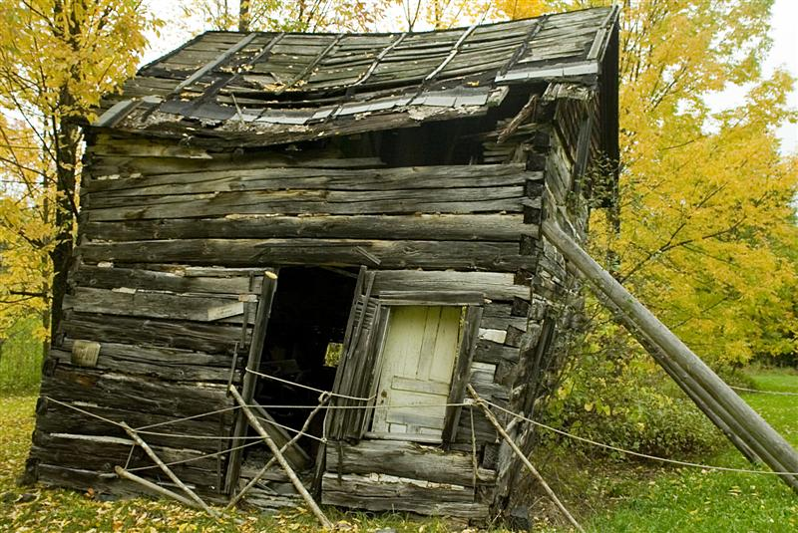
IS NOT a CIP Project
Governor's Finance Office - February 25, 2026

Slide 55
CIP Application Overview
Access the State Public Works Division (SPWD) Agency Project Submittal Website at https://nvcipportal.nv.gov.
Register for a login to the website and follow the provided guidance.
The deadline for submitting the web-based application form on the SPWD website is April 1, 2026.
Plan to present your project to the SPWB on August 28 – 29, 2026.
Unfunded Projects from last session are pre-loaded.
Governor's Finance Office - February 25, 2026

Slide 56
Application Selections
Administrative
Narrative
Outside Funding Sources
Site Analysis
Programming
Office Space Planning
Governor's Finance Office - February 25, 2026

Slide 57

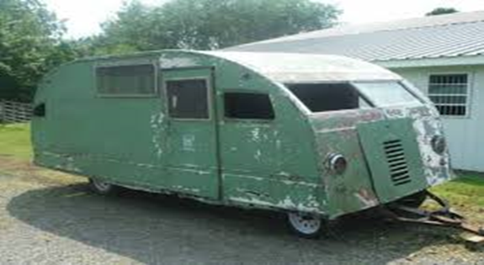
Clear and Concise
This is what you wanted:
Results of an incomplete and confusing CIP application
This is what you described:
Governor's Finance Office - February 25, 2026

Slide 58
Administrative Section
Project name, project description, location, requesting agency, contact person, etc.
Governor's Finance Office - February 25, 2026

Slide 59
Narrative Section
Justification and Background
  What is the driving need for your project?
Ramifications if project is not approved
Health safety and legal issues
What is the latest date this project could be completed without disrupting your program and why?
Governor's Finance Office - February 25, 2026

Slide 60
Outside Funding Sources Section
Not Required if State funding only
Proposed Funding Breakdown and Sources
State Match Requirements and Restrictions
Agencies’ actions to make funding available
Funding Availability / Funding Expiration
Governor's Finance Office - February 25, 2026

Slide 61
Site Analysis Section
New construction only
Estimated land area to be acquired and at what cost
Site utility needs
Known Offsite Improvements
Governor's Finance Office - February 25, 2026

Slide 62
Programming Section
New construction, building remodels and additions only
Square Footage Requirements
Occupancy Type
Staff Count (FTEs)
Furnishings, Fixtures, and Equipment (FF&E)
Governor's Finance Office - February 25, 2026

Slide 63
Office Space Planning
New construction, building remodels and additions only
SPWD will use these responses to identify office space consolidation opportunities.
Potential Leased Space Consolidation
Potential State-Owned Office Space Consolidation
Describe the long-term goals
Governor's Finance Office - February 25, 2026

Slide 64
Approval Process
July 2026 – SPWD Management review with each agency
August 28 – 29, 2026 – Agency presentation to State Public Works Board (SPWB)
September 2026 – SPWD Administrator’s recommendations to SPWB
October 1, 2026 – SPWB recommendations to the Governor
January 2027 – Executive budget submitted to Legislature
February – April 2027 – Legislative hearings
Governor's Finance Office - February 25, 2026

Slide 65
How do I Develop a Maintenance Project Request?
Facility Condition Assessment Reports
  Estimates for Facility Maintenance and Deferred Maintenance are planning level estimates only
  These estimates do not include soft costs (Permitting, Design Fees, Contingency, etc.)
  These planning level estimates should be substantiated with additional due diligence prior to making budget requests.
Governor's Finance Office - February 25, 2026

Slide 66


Leasing Services Section
Key Objectives:
  Maximize Utilization of State-Owned Buildings
  Ensure existing state facilities are fully leveraged before seeking private space.
  Strategic Space Planning
  Align agency relocations and expansions with long-term state facility goals.
  Cost Savings
  Minimize lease expenses through efficient planning and resource allocation.
  Efficiency & Consolidation
  Identify opportunities to consolidate agencies into shared state-owned spaces.
Governor's Finance Office - February 25, 2026

Slide 67

State-Owned vs Leased
Available State-Owned Space - https://publicworks.nv.gov/uploadedFiles/publicworksnvgov/content/Services/Leasing_Services/StateVacantSpace(4).xlsx
Request & Justification Forms - https://publicworks.nv.gov/Services/Leasing_Services/Processes_and_Forms/
Governor's Finance Office - February 25, 2026

Slide 68
Rental Agrmt. & Budget Accuracy
Leasing Services Responsibilities:
  Provide rental agreements with space layout and allocations
  Ensure accurate B&G rent coding
  Maintain billing consistency
  Bill quarterly, pulled out the second month of each quarter, based on Budget Build coding or approved revisions
Agency Responsibilities
  Update Leasing Services Section with current budget information
    Confirm funding sources
  Review and update funding sources during budget preparation
    Ensure accuracy before submission.
  Verify B&G rent coding
    Prevent errors and avoid billing issues
  Double-check final rent coding during budget closing
    Validate all entries for accuracy prior to finalization.
Governor's Finance Office - February 25, 2026

Slide 69
Leases
Leasing Services Responsibilities
What We Can Do for You
  Provide expert support for all leasing needs, from new space requests to renewals.
Strategic Space Planning
  Leasing Services is more than managing leases—we focus on optimizing space for efficiency and cost savings.
Market Analysis for New Space or Relocations
  Deliver data-driven insights to help agencies make informed decisions.
Governor's Finance Office - February 25, 2026

Slide 70
Leases
Agency Responsibilities
Start the Process
  Contact Leasing Services for any lease activity—new leases, renewals, or negotiations.
Mandatory Coordination
  Agencies cannot sign or negotiate leases independently; all actions must go through Leasing Services.
Early Notification
  Notify Leasing Services at least 365 days before lease expiration or during Budget Build for new space needs.
Provide Required Documentation
  Current lease agreement, space request form, and budget coding.
Governor's Finance Office - February 25, 2026

Slide 71
Remember To
Include:
  Current rent abatements or increases tied to your lease
  All statewide leases (verify via Master Log): http://publicworks.nv.gov/Services/Leasing_Services/Real_Property_Inventory_List/
Plan Ahead:
  Submit Budget Planning Form and allow 30 days for processing: https://publicworks.nv.gov/uploadedFiles/publicworksnvgov/content/Services/Leasing_Services/BudgetSRandSJForm.xlsx
Market Analysis Support:
  Available upon form submission
  Provides estimated rental rates based on current market conditions
Governor's Finance Office - February 25, 2026

Slide 72
Items to Consider When Estimating Facility Needs
New Staff =
New Space
Refer to our Space Justification form for statewide standards
Existing Equipment & Furniture
Moving Costs
Relocating
Renovations - this may include moving furniture
Telephone & Data Costs
Installation AND Ongoing Costs
May not always work in your new space
Relocations, Expansions
Additional Staff
Governor's Finance Office - February 25, 2026

Slide 73
After Budget Approval
NRS 331.110
Complete a space request for a new facility, expansion or renewal of an expiring lease, 365 days in advance
Remodels, expansions, and reconfigurations of leased facilities MUST be initiated and completed through SPWD, Leasing Services
Policies and request forms can be found at: http://publicworks.nv.gov/Services/Leasing_Services/Processes_and_Forms/
Governor's Finance Office - February 25, 2026

Slide 74
Leasing Services
Telephone: (775) 684-1815
E-mail: leasingservices@admin.nv.gov
Webpage: forms, important information and additional resources
  http://publicworks.nv.gov/Leasing_Services/
Governor's Finance Office - February 25, 2026

Slide 75
QUESTIONS?
budget@admin.nv.gov
Governor's Finance Office - February 25, 2026

Slide 76

10 Minutes
Break
Governor's Finance Office - February 25, 2026

Slide 77
Office of Federal Assistance
A’Keia Sanders
Director
Office of Federal Assistance
Governor's Finance Office - February 25, 2026

Slide 78

OFA Mission & Strategic Role
The Governor’s Office of Federal Assistance (OFA) serves as Nevada’s centralized coordination and compliance entity for federal and non-federal assistance, supporting agencies in identifying, applying for, and managing grant funding in alignment with the State Plan for Maximizing Federal Assistance and the Governors 3-Year Plan.
OFA Core Functions
➤ Centralized coordination of federal and non-federal assistance (SAM 3003)
➤ Intergovernmental Review / Single Point of Contact (EO 12372)
➤ Compliance and risk mitigation support
➤ Grant access and technical assistance
➤ Cross-agency coordination and strategic alignment
➤ Training and workforce development
➤ Grant writing and management support
➤ Grant Matching Program coordination (NRS 223.490)
Governor's Finance Office - February 25, 2026

Slide 79
Single Point of Contact & Intergovernmental Review
OFA is Nevada’s designated SPOC (EO 12372)
Coordinates in-state grant applications subject to EO 12372
SF-424 indicates if review is required
Agencies must notify OFA of ALL grants applied for, received, amended, or at risk of being returned to the Federal Government (NRS 223.480)
Submit through OFA’s online automated form

Slide 80
Why This Matters
Supports accurate, transparent federal revenue budgeting
Avoids delays and corrective budget actions
Ensures grant-funded positions and costs are fully supported
Strengthens compliance, audit readiness, and risk management

Slide 81
Accurately Budget Federal Revenues by Grant
Budget only revenues received directly from the federal government as Federal Revenue; record funds passed from another state agency as Transfer In.
Report federal revenues by individual grant award, including federal agency, grant title, revenue GL (3401–3600), and amount.
Use the most accurate biennial projections available and align base federal revenues to fully support any positions funded in whole or in part by the grant.

Slide 82
Use Correct Revenue GLs and Identify New Federal Funding Properly
Do not use generic titles such as “Federal Funds”, clearly specify grant name and fund type.
New federal revenue sources must be identified in both the Agency Request Budget and NEBS.
If a new revenue GL is needed, select the closest appropriate GL from the Controller’s chart of accounts and obtain Budget Division and Controller’s Office approval before use.

Slide 83
Required Documentation
Provide Notice of Grant Award (NoGA) or equivalent documentation for all increases or decreases.
  If adding an award that you have not yet received, attach your entire grant application.
Include detailed calculations for carryforward of unspent balances and reconcile projections to the award amount by fiscal year.
Maintenance of Effort Form (if applicable)
Grant Match Summary Form (if applicable)

Slide 84
Decision Unit – E490-E499
Expiring Grant/Program – grant/program expiring/sunsetting during the upcoming biennium
  Make sure that if you have positions paid off the grant you eliminate them
  If you intend on bringing those positions back under another funding source, you will need to submit an enhancement

Slide 85
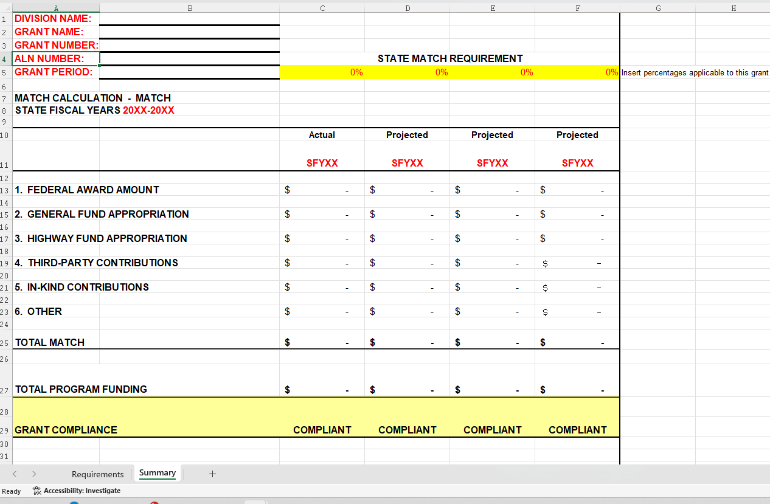
Grant Match Summary Form

Slide 86
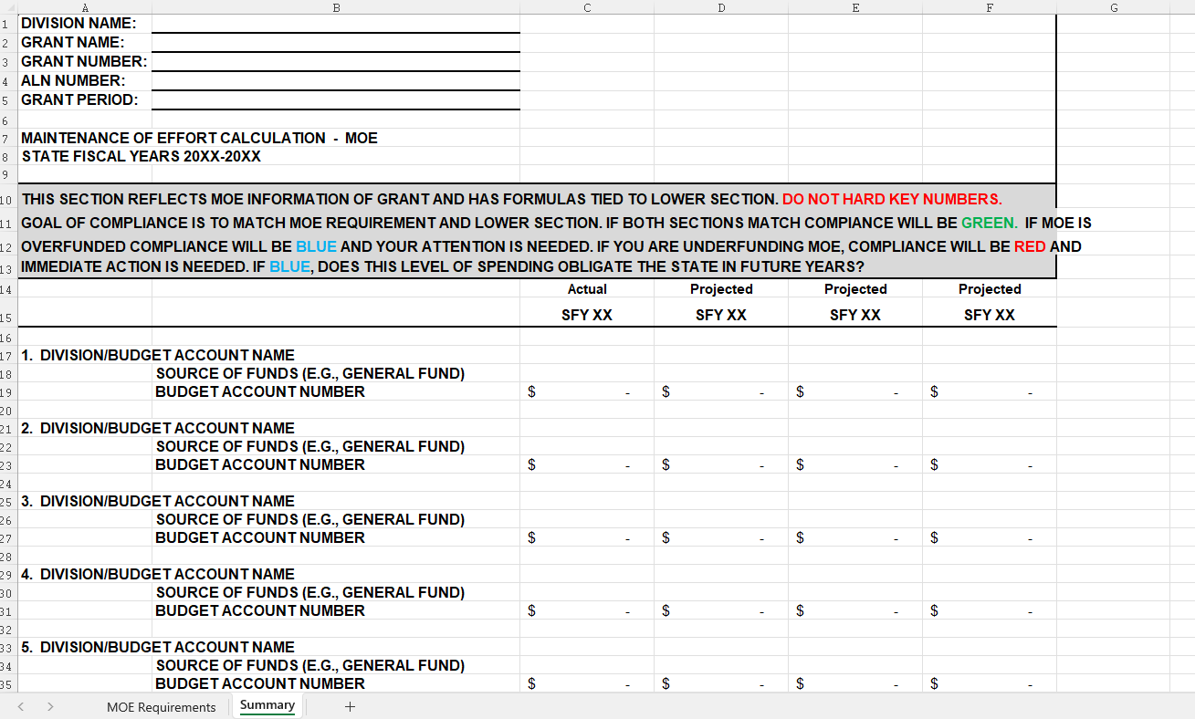
Maintenance of Effort Form

Slide 87
Attachment in NEBS

Slide 88
Questions???
Governor's Finance Office - February 25, 2026

Slide 89
Fleet Services Division
Robbie Burgess
Administrator
Fleet Services Division
Governor's Finance Office - February 25, 2026

Slide 90
Fleet Services Division
Mission
Provide superior customer-driven service to state agencies while being on the forefront in fleet management, alternative fuels and technology.
Strategy
Partner closely with the private sector to ensure the product we deliver to our customers is delivered in an efficient and cost-effective manner while focusing on one goal - solve our customers’ problems quickly and efficiently.
Statutory Authority
NRS 336
Governor's Finance Office - February 25, 2026

Slide 91
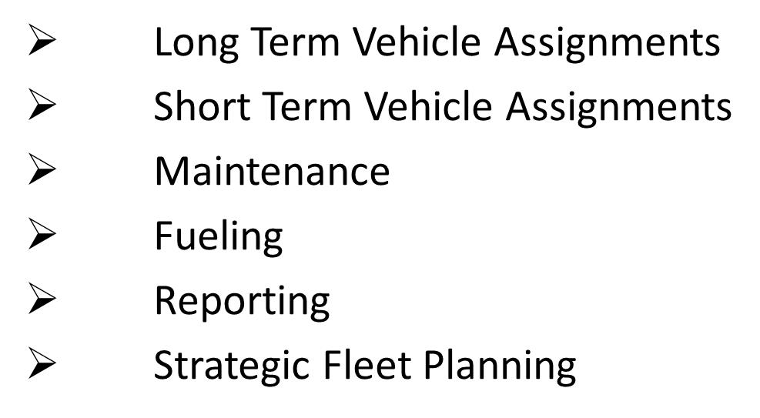
Services Provided
Governor's Finance Office - February 25, 2026

Slide 92
Long-Term Vehicle Request
Review your agency's mission and the tasks you are trying to achieve by leasing a vehicle.
Focus on what the vehicle needs to do, where it needs to go, how many people it needs to transport.
Does it need any specialized equipment? For example a camper shell, tool box, lift gate, service body, etc.
Do you really need four-wheel drive?
Does it need to be a specific color?
Click on the vehicle schedule link for a complete list of vehicle types offered.
Does the vehicle meet the utilization guidelines in SAM 1407? Fleet Services will be monitoring vehicle usage and maintenance requirements for all additional and existing vehicles within the agency.
Please contact the division administrator for any questions or concerns at (775) 684-1883 or CarsonFleet@admin.nv.gov
Governor's Finance Office - February 25, 2026

Slide 93
Hybrid or EV
To adhere to AB262 from the 82nd Legislature
Are you looking to move your agency-assigned vehicles toward hybrid or electric vehicle technology in the next biennium?
Both EVs and hybrid vehicles are available to choose in the NEBS Vehicle Schedule.
Call the Fleet Services Division to discuss which vehicle would be best for your agency to request.
Governor's Finance Office - February 25, 2026

Slide 94
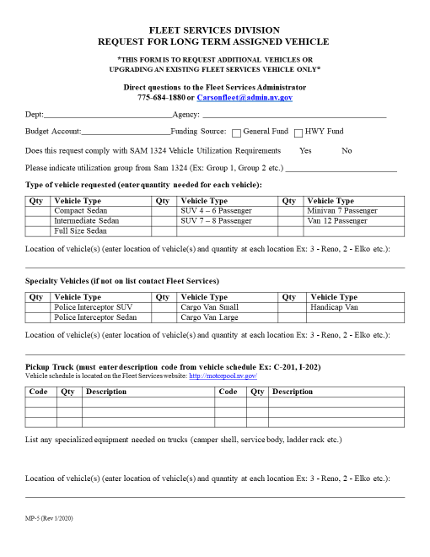
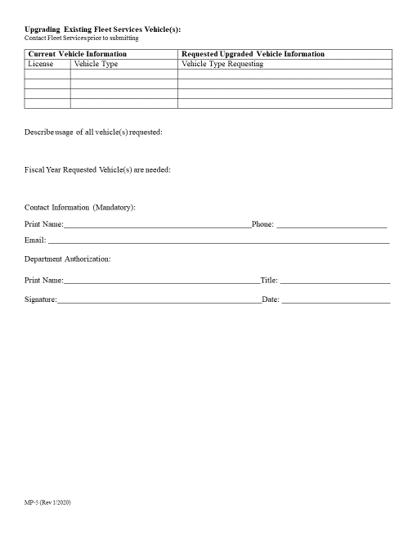
MP-5
Request for Long-Term Assigned Vehicle
Governor's Finance Office - February 25, 2026

Slide 95
Vehicle Schedule
Governor's Finance Office - February 25, 2026

Slide 96
Forms and Vehicle Schedule
All of the Fleet Services Division forms including the MP-5 Long-Term Vehicle Request and the Vehicle Schedule can be seen on our website.
www.fleetservices.nv.gov
Governor's Finance Office - February 25, 2026

Slide 97
Questions???
Governor's Finance Office - February 25, 2026

Slide 98
Division of Human Resources Management
Bachera L. Washington
Administrator
Division of Human Resource Management
Governor's Finance Office - February 25, 2026

Slide 99
DIVISION OF HUMAN RESOURCE MANAGEMENT
Classified and Unclassified
Position Requests
Governor's Finance Office - February 25, 2026

Slide 100
HR-19 Process
Division of Human Resource Management
Governor's Finance Office - February 25, 2026

Slide 101
Classified Positions
HR-19s for all requests
Pre-Legislative Reviews
  New budgeted positions
  Reclassification of vacant positions
  Instructional Memo coming next month!
Governor's Finance Office - February 25, 2026

Slide 102
Unclassified Position Process
Division of Human Resource Management
Governor's Finance Office - February 25, 2026

Slide 103
Unclassified Positions
List of all GO approved unclassified position requests
  Form submitted to DHRM
    Job duties
    Minimum qualifications
    Supervisory and/or budgetary responsibilities
Governor's Finance Office - February 25, 2026

Slide 104
Unclassified Positions
DHRM determines:
Does an existing unclassified OR classified Job Title exist?
Governor's Finance Office - February 25, 2026

Slide 105
Unclassified Positions
Consolidating unclassified jobs, where possible
Moving jobs from classified to unclassified/unclassified to classified
Eliminating unused U-codes & Job Titles
Governor's Finance Office - February 25, 2026

Slide 106
Bill Draft Requests Expectations
Isabel Graf
Policy Director
Governor’s Office
Governor's Finance Office - February 25, 2026

Slide 107
Policy Bill Draft Requests Concept Process
Agencies should refer to the email sent to directors on January 16, 2026, for additional information.
The Governor's Office anticipates two types of BDRs from agencies:
1. Corrective BDRs – Corrective BDRs consist of language to fix issues with existing statute(s) that inhibit an agency's efficiency or ability to accomplish its mission or directives.
2. Core BDRs – Core BDRs must be aligned with the Governor's 3-Year Plan/Policy Matrix
Governor's Finance Office - February 25, 2026

Slide 108
BDRs are Classified as Either:
Policy BDR
  Housekeeping – Clarification or minor changes to existing statutes
  Substantive – All other requests
  OR
Budgetary BDR
  Fiscal impact greater than $2,000
Governor's Finance Office - February 25, 2026
Notes:
There are two types of BDRs, Policy and Budgetary
Agencies need to consider whether a BDR has an impact on their budget submission. If it does, it should be submitted as a Budgetary BDR.
No fiscal impact = Policy BDR
Any fiscal impact greater than $2,000 = Budgetary BDR

Slide 109
Policy BDR
Corrective – Clarification or minor changes to existing statutes
Core – All other requests
No material fiscal impact
Governor's Finance Office - February 25, 2026
Notes:
Housekeeping BDRs are mostly for cleanup of existing language. Examples of housekeeping BDRs are revisions to align with existing policies, fixing language approved in the prior session, or clarifying existing practice.
Substantive policy BDRs are mostly for major revisions or additions to statutes
After the language is finalized and approved by the Governor's Office, the BDR is submitted to the Legislative Counsel Bureau who will work with the agency to draft the legal wording for the measure.
Final language for all measures must be completed, and the bill draft pre-filed prior to the statutory deadline of the 3rd Wednesday in November preceding the Legislative Session.

Slide 110
Budgetary BDR
Necessary to implement the budget proposed by the Governor
Fiscal Impact Exceeding $2,000 (NRS 218D.430)
The fiscal impact of items included in the Executive Budget should not also be included in the fiscal note
Governor's Finance Office - February 25, 2026
Notes:
Budgetary BDRs should note the change being proposed in their submitted budget and what the fiscal impact will be.
There should be a corresponding Decision Unit in NEBS that references the BDR# in the Decision Unit narrative.
Budgetary BDRs are due to the Budget Division by 8/14/2026 along with the Agency Request Submittal

Slide 111
Preliminary meeting with Policy Director and Policy Liaison within the Governor's Office to discuss BDR concepts
  Now until March 15, 2026
BDR Concepts due to the Governor's Office (Policy Director)
  March 15, 2026
Meeting with Governor's staff to review and approve concept policy BDRs
  April 1 through April 30, 2026
Final BDR concept presentations/NEBS submittal
  June 1, 2026 through June 12, 2026
Final review period (Governor’s staff will review presentations & make requests for final agency adjustments; review by Governor)
  June 12 through July 29, 2026
August 1, 2026: Final Drafts of Policy BDRs to LCB
Governor's Finance Office - February 25, 2026
Notes:
February 1-March 15, 2026: Preliminary Meetings
The Governor's staff have already begun meeting with agencies to review and approve concepts for BDRs.
Our goal is to have all proposed BDR concepts reviewed and approved or rejected before (March 15, 2026)
The Governor's staff will be reaching out to each agency director in advance of this deadline to schedule follow-up meetings in April.
April 1-April 15, 2026: Follow-up Meetings
Starting April 1st, the Governor's staff will begin follow-up meetings to facilitate continued development of approved BDR concepts with individual agencies.
The Governor's policy staff will be scheduling these meetings at the same time as they schedule the preliminary meetings to ensure adequate time for development.
These meetings should take place about 30 days after preliminary meetings with the Governor's staff to afford agencies sufficient time to build out their initial concepts.
Conversations between the Governor's staff and agencies involving BDR development will not be limited to scheduled meetings; communications, as needed, is encouraged throughout the process.
Our goal is to have all Corrective and Core BDRs developed for final presentation by (insert date)
June 1-June 12, 2026: Presentations
Starting June 1st, agencies should be prepared to begin final presentations of their BDRs to the Governor's staff.
Presentations will be scheduled by the Governor's policy staff as they work with agencies to develop their BDRs through the follow-up meeting process.
Our goal is to have all agency presentations complete by June 12th and agency submission in NEBS is also due on that day.
June 12 – July 29, 2026: Final Review Period
Starting June 12, the Governor's Office will begin a final review period of agency BDRs. This process will consist of the following steps:
Staff review agency presentations
Agency adjustments to BDRs in conjunction with requests from the Governor's staff
Final review – Governor Lombardo
Our goal is to have all final drafts of Corrective and Core BDRs processed and reviewed by July 15, 2026, with a final deadline of July 29th.
August 1, 2026: Final Drafts of Corrective and Core BDRs to LCB

Slide 112
Fiscal Notes
Christian Thauer
Principal Program Analyst
Fiscal Analysis Division
Legislative Counsel Bureau
Governor's Finance Office - February 25, 2026

Slide 113
(New) LCB Fiscal Notes Team
Cheryl Harvey, Management Analyst II
Colby Nichols, Program Analyst
Morgan Barlow, Program Analyst
Additional support during session
Still involved: Michael Nakamoto, Chief Principal Deputy Fiscal Analyst
Governor's Finance Office - February 25, 2026

Slide 114
What Are Fiscal Notes?
Provide estimate of fiscal impact of proposed legislation.
Essential part of state legislative processes across the U.S.
How fiscal notes are created, who provides estimates on fiscal impacts, and the specific information that must be provided, differ across states.
Governor's Finance Office - February 25, 2026

Slide 115
Fiscal Notes in Nevada
Governed by NRS 218D.400 through 218D.495, as amended by AB 249 of the 83rd Session (2025).
Required for bills or joint resolutions (JR) that
  Decrease revenue or increase expenditures;
  Increase or newly provide for term of imprisonment or make release on parole less likely. (NRS 218D.430)
Governor's Finance Office - February 25, 2026

Slide 116
Overview: Fiscal Notes Process In NV Involving State Agencies
Step 1: LCB determines whether a bill or JR requires a fiscal note and sends fiscal note request(s) to the respective state agencies.
Step 2: State agencies provide estimate of fiscal impact of the BDR/bill.
Step 3: GFO approves or rejects executive branch agencies’ fiscal note(s) – or submits supplementary fiscal notes.
Step 4: LCB compiles and prints fiscal notes.
Governor's Finance Office - February 25, 2026

Slide 117
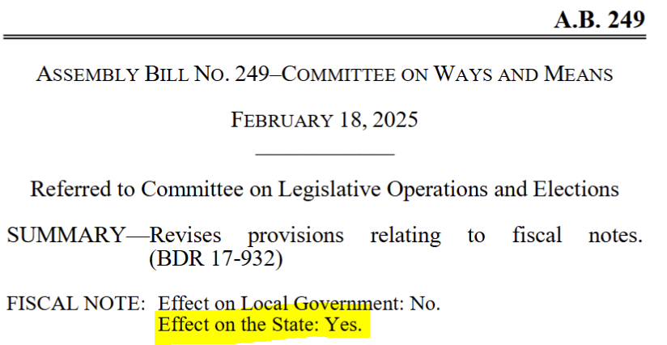
Step 1: LCB
LCB Legal designates each BDR as having or not having a fiscal impact (NRS 218D.415).
Example 2025 Session:
Governor's Finance Office - February 25, 2026

Slide 118
Step 1: LCB
AB 249 of the 83rd Session (2025) revised the designations that LCB Legal makes.
Main changes:
  Designation of a positive “Effect on the State”: From “Yes” to “May Have Fiscal Impact”; and
  Inclusion of designation of fiscal effect on the Highway Fund.
Governor's Finance Office - February 25, 2026

Slide 119
Step 1: LCB
LCB designations, as amended by AB 249 of the 83rd Session (2025), concerning the “Effect on the State”:
“May have Fiscal Impact”;
“No”;
“Contains Appropriation from the State General Fund included in Executive Budget”;
“Executive Budget”;
“Contains Appropriation from the State General Fund not included in Executive Budget”.
Governor's Finance Office - February 25, 2026

Slide 120
Step 1: LCB
LCB designations, as amended by AB 249 of the 83rd Session (2025), concerning the “Effect on the State Highway Fund”:
“May have Fiscal Impact”;
“No”;
“Contains Appropriation from the State Highway Fund included in Executive Budget”;
“Contains Appropriation from the State Highway Fund not included in Executive Budget”.
Governor's Finance Office - February 25, 2026

Slide 121
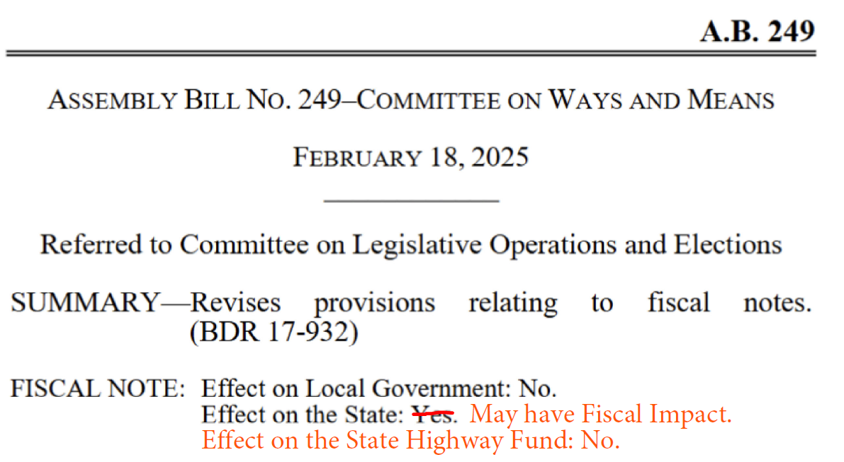
Step 1: LCB
The same example would be designated as indicated in red for the 2027 Session, given the changes enacted by AB 249 of the 83rd Session (2025):
Governor's Finance Office - February 25, 2026

Slide 122
Step 1: LCB
BDRs/bills designated as having a fiscal impact are sent to the Fiscal Analysis Division for assignment to affected agencies.
Fiscal notes are not required on any measure relating exclusively to the proposed Executive Budget. (NRS 218D.430)
Governor's Finance Office - February 25, 2026

Slide 123
Step 2: Agency
Fiscal notes are created by affected agencies (NRS 218D.430); agencies use web-based system to create, process and submit fiscal notes.
Fiscal notes must provide reliable estimates of changes in appropriation authority, fiscal liability or state revenue. (NRS 218D.430)
They must be factual and concise, including a reliable estimate of the dollar amount of the effect of the bill or joint resolution. (NRS 218D.470)
Governor's Finance Office - February 25, 2026

Slide 124
Step 2: Agency
If no dollar amount can be estimated, the note must state so with reasons for such a conclusion.
State agencies have 5 working days, including review by GFO (in case of executive branch agencies), to submit a fiscal note. (NRS 218D.475)
Upon request, this period may be extended by up to 10 additional working days. (NRS 218D.475)
Governor's Finance Office - February 25, 2026

Slide 125
Step 3: GFO
GFO reviews fiscal note submitted by executive branch agencies within the electronic system, approves or rejects it.
If GFO approves, the web-based system sends the fiscal note to LCB for compilation and printing.
If GFO rejects fiscal note, the system sends the fiscal note back to the executive agency for reconsideration.
If Director of GFO disagrees with a fiscal note, he/she may submit a supplementary fiscal note.
Governor's Finance Office - February 25, 2026

Slide 126
Step 4: LCB
Fiscal Analysis Division performs a cursory review of submitted fiscal notes.
After a BDR is introduced, the respective fiscal note(s) are printed by the State Printing Office and are posted in the Nevada Electronic Legislative Information System (NELIS).
Governor's Finance Office - February 25, 2026

Slide 127
Fiscal Notes in Nevada
Important to know: Confidentiality of BDRs
Often, fiscal notes will be requested on BDRs before introduced as a bill or joint resolution.
If so, the BDR sent with the fiscal note request, any other information on the BDR, as well as the fiscal note itself are considered confidential until the BDR is introduced. (NRS 218D.495)
A person who knowingly violates these provisions is guilty of a misdemeanor. (NRS 218D.495)
Governor's Finance Office - February 25, 2026

Slide 128
Fiscal Notes in Nevada
Important to know: Fiscal notes in the legislative process
Fiscal notes are pursuant to NRS 218D.400 through 218D.495 only required on the As Introduced-version of bills or JRs (not on Reprints).
Must be obtained before a vote is taken on a bill or joint resolution by a Senate or Assembly Committee. (NRS 218D.430)
Governor's Finance Office - February 25, 2026

Slide 129
Fiscal Notes in Nevada
Important to know: Fiscal notes vs. unsolicited fiscal notes
What if…
  you see a bill or joint resolution with a fiscal impact on your agency, but you have not received a fiscal note request from the Fiscal Analysis Division?
  The amended version of a bill or joint resolution created or changed the fiscal impact on your agency?
You have the option to submit an unsolicited fiscal note.
Unsolicited fiscal notes are sent to LCB and GFO simultaneously and are also made available in NELIS.
Governor's Finance Office - February 25, 2026

Slide 130
Timeline
October/November 2026 – Each agency is requested to provide contact who will act as agency-level fiscal note administrator.
November/December 2026 – Fiscal Analysis Division will hold Fiscal Notes System training.
December 2026/January 2027 – Agencies will begin receiving fiscal note requests for 2027 Session.
Governor's Finance Office - February 25, 2026

Slide 131
Thank you!
For any additional questions, please contact:
Cheryl Harvey, LCB Fiscal Analysis Division
Phone number: (775) 684-6872
E-mail address: charvey@lcb.state.nv.us
Governor's Finance Office - February 25, 2026

Slide 132
10 Minutes
Break
Governor's Finance Office - February 25, 2026

Slide 133
Budget Building Manual, Bill Changes, and Important Dates and Deadlines
Dustin Speed
Executive Branch Budget Officer
Governor’s Finance Office
Governor's Finance Office - February 25, 2026

Slide 134
Budget Building Manual Overview
Updated every two years to be used as a “how to” guide to help agencies build budgets.
Includes the Governor’s Policy Matrix
Includes a glossary of definitions
Includes a styling guide to help with your writing
Governor's Finance Office - February 25, 2026

Slide 135
Budget Building Manual Overview continued
Can be used to set up in house training
Available on the Governor’s Finance website at https://budget.nv.gov

Slide 136
What is new
New Program Plan section (formerly the Business Plan section)
  Refer to page 27 of the 27-29 Budget Building Manual
Federal Grant Requirements section
  Refer to page 55 of the 27-29 Budget Building Manual
Using Copilot/AI section
  Refer to page 151 of the 27-29 Budget Building Manual

Slide 137
Bill Changes
AB 356
The Governor must include agreed upon amounts from collective bargaining agreements in the biennial executive budget.
If this is not practicable, a report explaining why must be submitted to the Legislature the same day as the budget.
Negotiations start on or before April 1st of each even numbered year (previously October 1st)
Governor's Finance Office - February 25, 2026

Slide 138
AB 356
Arbitration deadlines
Arbitration begins September 15th (previously February 15th).
Decision due by December 5 (previously March 5th ).
Economic Forum Report
Deadline has moved from December 3rd to November 15th of each even numbered year.
Governor's Finance Office - February 25, 2026

Slide 139
SB 419
Contracting Authority
The Director of the Legislative Counsel Bureau can now enter into contracts to assist with revenue forecasting and data processing services.
Report Deadlines
The Economic Forum’s second report deadline is April 1st of each odd-numbered year (previous deadline was May 1st ).
Governor's Finance Office - February 25, 2026

Slide 140
SB 462
Adjusted Base
Adjusted base budget is now based on revenues and expenditures from the even numbered year of the biennium.
Included Costs
Costs for continuing programs.
Costs for new or enhanced programs.
Governor's Finance Office - February 25, 2026

Slide 141
SB 462 continued
Removal of one-time expenditures and expired programs.
Changes in revenue authority, travel, rent, insurance, and cost allocations.
Ongoing contractual obligations and expenditures approved by the Interim Finance Committee.
Annualization of partial-year costs and grant related revenues.
Other necessary adjustments based on expenditure limits or the GFO Director’s discretion.
Governor's Finance Office - February 25, 2026

Slide 142
SB 462 continued
Rainy Day Fund
The cap on the Account to Stabilize the Operation of the State Government (Rainy Day Account) is based on the previous fiscal year’s appropriations and authorized expenditures.
Cost Allocation Plan
Responsibility for preparing Annual Statewide Cost Allocation Plan (SWCAP) moves from the Administrator of the Administrative Services Division to the Budget Division of the Office of Finance.
Governor's Finance Office - February 25, 2026

Slide 143
Important Dates
Task | Deadline
Uniform Schedule to Agencies | 1/15/2026
2027-29 Governor's Finance Office Budget Kickoff | 2/25/2026
Bill Draft Request (BDR) Policy Bills-Concept | 3/15/2026
Governor meeting with Agencies to review and approve concept policy BDRs | 04/1- 04/30/2026
Agency submittal of Capital Improvement Project (CIP) and Deferred Maintenance requests over $100,000 to the State Public Works Division | 4/1/2026
Technology Investment Evaluations (TIE) due to GTO | 4/1/2026
Collective Bargaining Agreement (CBA) Negotiations, Mediation Period (NRS 288.400 - 288.630) | 4/1-12/5/2026
Final BDR concept follow up/NEBS BDR Module entry | 06/1-06/12/2026
Class Series Compensation Plan Requests | 6/3/2026
New vehicle request submitted to Fleet Services Administrator (MP-5 Form) | 7/1/2026
Governor's Finance Office - February 25, 2026

Slide 144
Important Dates
Task | Deadline
Agencies must have preliminary Governor's Technology Office utilization (GTO schedules) completed in NEBS | 7/8/2026
Payroll information for authorized Full-Time Equivalent (FTE) positions into NEBS as of June 30, 2026 | 7/13/2026
Agencies must have preliminary monthly Fleet Services vehicles completed in NEBS | 7/20/2026
GTO provides schedule of approved utilizations by budget account | 7/24/2026
Governor approved Policy Bill Draft Requests | 7/29/2026
Agencies must have FINAL GTO utilization (Technology Services schedules) completed in NEBS | 7/31/2026
Policy Bill Draft Requests (BDRs) due to Legislative Counsel (NRS 218D.175 sec.1) | 8/1/2026
Budgetary Bill Draft Requests (BDRs) due to the Governor's Finance Office | 8/14/2026
CIP presentations to the State Public Works Board | 8/28-29/2026
Governor's Finance Office - February 25, 2026

Slide 145
Important Dates
Task | Deadline
Submittal of Agency Request Budget by 4:00 p.m. | 9/1/2026
Agency Budget Presentation to Governor's Office, Governor's Finance Office, and Legislative Council Bureau | 9/21-10/2/2026
Agency Request Version becomes public (NRS 353.211) | On or Before 10/15/2026
Adjusted Base questions sent to agencies | 11/9/2026
Economic Forum Report to the Governor | 11/17/2026
Adjusted Base completed and Concurrence with LCB (FTE reconciled; M-150 adjustments made; Vacancy Savings complete) | 12/2/2026
Collective Bargaining Agreement (CBA) Budget Finalization | 12/7-12/11/2026
Final Enhancement Decisions | 12/1-12/30/2026
Updated Supplemental Appropriation Requests due | 12/20/2026
Printing Governor's Recommended Budget (No changes) | 1/1-1/10/2027
Source: 2027-2029 Budget Building Manual. Page 13
Governor's Finance Office - February 25, 2026

Slide 146
Questions?
Answers!
Tiffany Greenameyer
Director
Governor’s Finance Office
Governor's Finance Office - February 25, 2026

Slide 147
Thank You!
Governor’s Finance Office
Budget Division
Hours: 8 - 5, Monday - Friday
209 East Musser Street, Room 200
Carson City, Nevada 89701-4298
Phone: 775-684-0222
Fax: 775-684-0260
Email: Budget Division
Graphic is a product of Microsoft 365 Copilot
Governor's Finance Office - February 25, 2026

